Slide 1
Lecture 4
CSE202: OBJECT ORIENTED PROGRAMMING

Slide 2
Outline
Structure
Union
Enumeration and Classes

Slide 3



Why Use Structures?
Quite often we deal with entities that are collection of dissimilar data types.
For example, suppose you want to store data about a car. You might want to store its name (a string), its price (a float) and number of seats in it (an int).
If data about say 3 such cars is to be stored, then we can follow two approaches:
  Construct individual arrays, one for storing names, another for storing prices and still another for storing number of seats.
  Use a structure variable.

Slide 4
Introduction
Structures are user defined data types
Structures
  Structure is a group of data items of different data types held together in a single unit.
  Collections of related variables under one name
    Can contain variables of different data types
  Commonly used to define records to be stored in files.

Slide 5
Structure
There are three aspects of working with structures:
  Defining a structure type
  Declaring variables and constants of newly created type
  Using and performing operations on the objects of structure type

Slide 6
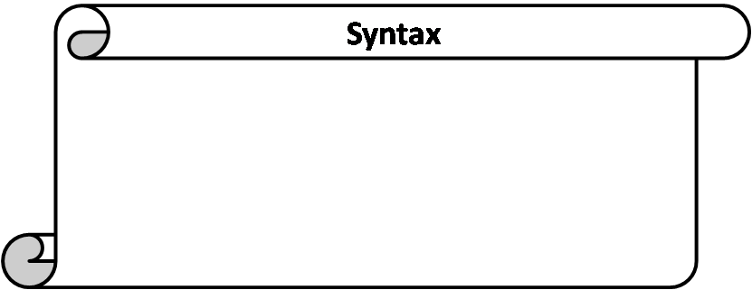
Structure Definition
struct sname {
type var1;
type var2;
type var3;
.
.
type varN;
};
struct is a keyword to define a structure.
sname is the name given to the structure/structure tag.
type is a built-in data type.
var1,var2,var3,…..,varN are elements of structure being defined.
; semicolon at the end.

Slide 7
Structure Definitions
Example:
      struct car{
      char n[20];
      int seats;
      float price
      };
  struct keyword introduces the definition for structure car
  car is the structure name or tag and is used to declare variables of the structure type
  car contains three members of type char, float, int
    These members are name, price and seats.
No variable has been associated with this structure
No memory is set aside for this structure.

Slide 8
Structure Definitions
struct information
  A structure definition does not reserve space in memory .
    Instead creates a new data type used to define structure variables
Defining variables of structure type
  Defined like other variables:
      Car myCar1,mycar2…
  Can use a comma separated list along with structure definition:
      struct car{
      char n[20];
      int seats;
      float price;
      } myCar;
At this point, the memory is set aside for the structure variable myCar.

Slide 9
MCQ
Structure is a data type in which
A elements must have same data types
B elements may have different data types
C elements must have different data types
D none of these

Slide 10
Solution
Structure is a data type in which
A elements must have same data types
B elements may have different data types
C elements must have different data types
D none of these

Slide 11
MCQ
A structure is a collection of
A homogenous e elements
B heterogenous elements
C homogenous elements and heterogenous elements

Slide 12
Solution
A structure is a collection of
A homogenous e elements
B heterogenous elements
C homogenous elements and heterogenous elements

Slide 13
How the members are stored in memory
Consider the declarations to understand how the members of the structure variables are stored in memory
struct car{
int seats;
float price;
}myCar,
Note: all members are stored in contiguous memory location in order in which they are declared.

Slide 14
How the members of the structure variables are stored in memory
1197
1198
1199
1200
1201
1202
1203
1204
1205
1206
1207
1208
1209
1210
1211
seats
price

Slide 15
Program example of structure
#include <iostream>
using namespace std;
struct employee
{
char name[50];
int age;
float salary;
};
int main()
{
employee e1;
cout << "Enter Full name: ";
cin.get(e1.name, 50);
cout << "Enter age: ";
cin >> e1.age;
cout << "Enter salary: ";
cin >> e1.salary;
cout << "\nDisplaying Information." << endl;
cout << "Name: " << e1.name << endl;
cout <<"Age: " << e1.age << endl;
cout << "Salary: " << e1.salary;
return 0;
}

Slide 16
Union
Union is similar as structure. The major distinction between them is in terms of storage.
In structure each member has its own storage location whereas all the members of union uses the same location.
The union may contain many members of different data type but it can handle only one member at a time union can be declared using the keyword union.

Slide 17

Example
A class is a very good example of structure and union in this example students are sitting in contiguous memory allocation as they are treated as a structure individually. And if we are taking the place of teacher then in a class only one teacher can teach. After leaving the first teacher then another teacher can enter.

Slide 18
Union Declaration
union item
{
int m;
float x;
char c;
}code;
This declare a variable code of type union item

Slide 19
Unions
Valid union operations
  Assignment to union of same type: =
  Taking address: &
  Accessing union members: .
  Accessing members using pointers: ->

Slide 20
Program example of Union
#include <iostream>
union Data {
int intValue;
float floatValue;
char charValue;
};
int main() {
Data myData;
myData.intValue = 42;
std::cout << "Integer value: " << myData.intValue << std::endl;
myData.floatValue = 3.14f;
std::cout << "Float value: " << myData.floatValue << std::endl;
myData.charValue = 'A';
std::cout << "Char value: " << myData.charValue << std::endl;
return 0;
}

Slide 21
MCQ
Which statement is true in case of memory allocation of members of union
A Memory is allocated for all variables.
B Allocates memory for variable which variable require more memory.
C Allocates memory for variable which variable require less memory.
D none of these

Slide 22
Solution
Which statement is true in case of memory allocation of members of union
A Memory is allocated for all variables.
B Allocates memory for variable which variable require more memory.
C Allocates memory for variable which variable require less memory.
D none of these

Slide 23
MCQ
which is true in case of union
A require more memory space than Structure
B Declared with Struct Keyword
C require less memory space than Structure
D require more execution time than Structure

Slide 24
Solution
which is true in case of union
A require more memory space than Structure
B Declared with Struct Keyword
C require less memory space than Structure
D require more execution time than Structure

Slide 25
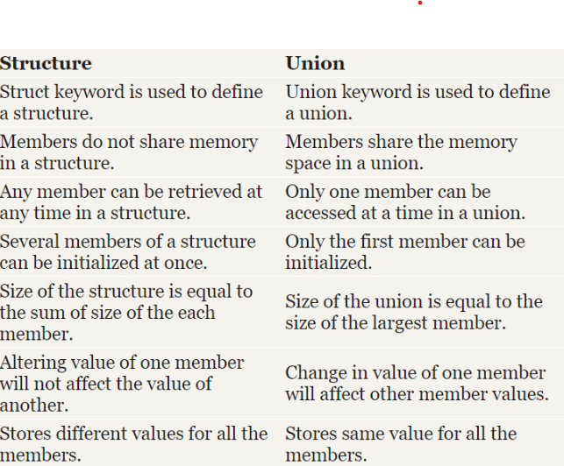
Difference between Structure and Union

Slide 26
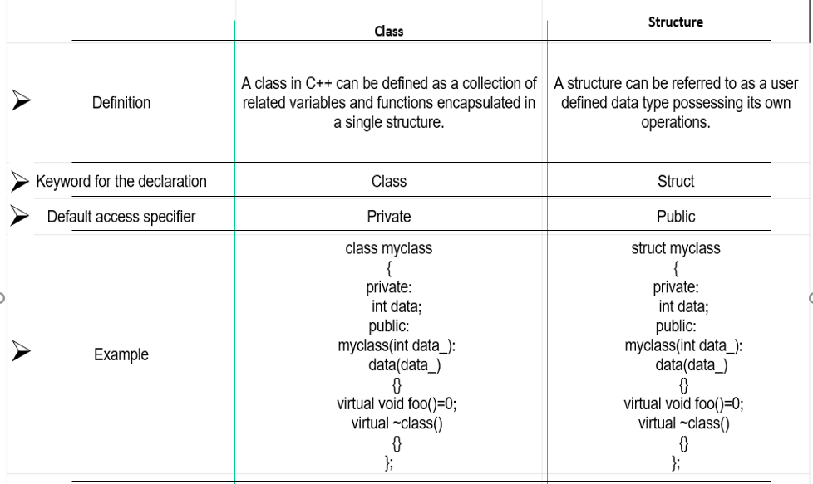

Slide 27
MCQ
C structure differs from CPP class in regards that by default all the members of the structure are __________ in nature.
a. private
b. protected
c. public
d. None of these

Slide 28
Solution
C structure differs from CPP class in regards that by default all the members of the structure are __________ in nature.
a. private
b. protected
c. public
d. None of these

Slide 29
Difference between C structures and C++ structures
Member functions inside structure: Structures in C cannot have member functions inside structure but Structures in C++ can have member functions along with data members.
Direct Initialization: We cannot directly initialize structure data members in C but we can do it in C++.
#include <iostream>
using namespace std;
struct Record {
int x = 7;
};
int main()
{
Record s;
cout << s.x << endl;
return 0;
}

Slide 30
Using struct keyword: In C, we need to use struct to declare a struct variable. In C++, struct is not necessary. For example, let there be a structure for Record. In C, we must use “struct Record” for Record variables. In C++, we need not use struct and using ‘Record‘ only would work.
Static Members: C structures cannot have static members but is allowed in C++.
struct Record {
static int x;
};
int main()
{
return 0;
}
Note: This will generate an error in C but no error in C++.

Slide 31
Constructor creation in structure: Structures in C cannot have constructor inside structure but Structures in C++ can have Constructor creation.
sizeof operator: This operator will generate 0 for an empty structure in C whereas 1 for an empty structure in C++.
Data Hiding: C structures do not allow concept of Data hiding but is permitted in C++ as C++ is an object oriented language whereas C is not.
Access Modifiers: C structures do not have access modifiers as these modifiers are not supported by the language. C++ structures can have this concept as it is inbuilt in the language.

Slide 32
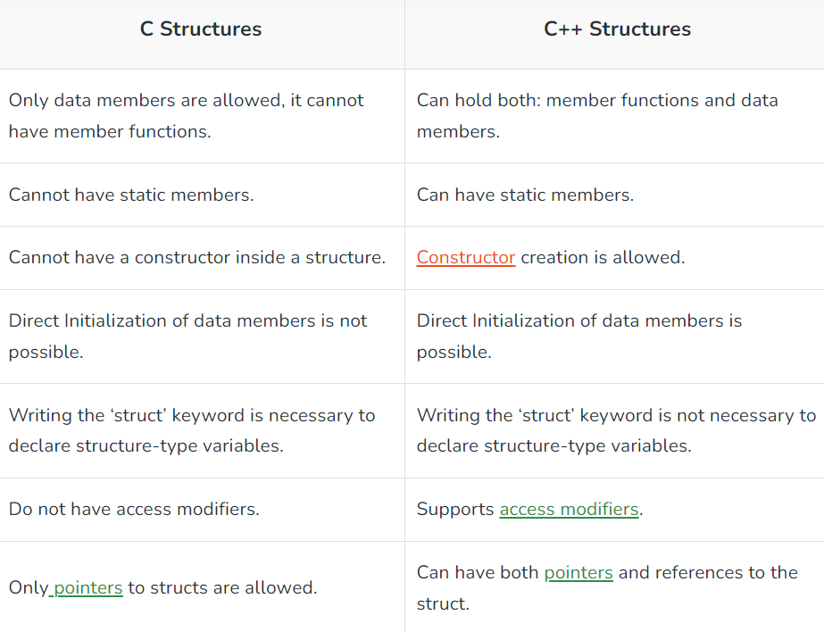
Difference between Structure in C and Structure in C++

Slide 33
Array of structure
The arrays and structures can be combined to form complex data objects. There may be structures contained within an array; also, there may be an array as an element of a structure.
Since an array can contain similar elements, the combination of structures within an array is an array of structures. To declare an array of structures, you must first define a structure and then declare an array variable of that type. For example, to store the addresses of 100 members of the council, you need to create an array.
Now, to declare a 100-element array of structures of type addr, we will write:
Syntax:- addr mem_addr[100];

Slide 34
Example of Array of Structure
#include<iostream>
using namespace std;
struct emp // structure name (emp)
{
string name; // structure member
};
int main()
{
emp e[5]; // array-of-structure variable (e[5])
int i;
for(i=0; i<5; i++)
{
cout<<"Enter the name of the employee no."<<i+1<<": ";
cin>>e[i].name;
}
cout<<"\nNames of all employees: \n";
for(i=0; i<5; i++)
{
cout<<e[i].name<<endl; } cout<<endl; return 0;
}

Slide 35
Example of Array of Union
#include <iostream>
using namespace std;
// Define a union to hold different data types
union Data {
int intValue;
char charValue;
double doubleValue;
};
int main() {
const int SIZE = 5;
Data dataArray[SIZE]; // Array of unions to store different data types
// Populate the array with data
dataArray[0].intValue = 42;
dataArray[1].charValue = 'A';
dataArray[2].doubleValue = 3.14;
dataArray[3].intValue = 100;
dataArray[4].charValue = 'Z';
// Access and display the data from the array
cout << "Array of Union:" << endl;
for (int i = 0; i < SIZE; ++i)

Slide 36
{
cout << "Index " << i << ": ";
// Since a union can only hold one value at a time, we need to know the type stored at each index
if (i % 3 == 0) {
cout << "Integer Value: " << dataArray[i].intValue << endl;
}
else if (i % 3 == 1) {
cout << "Character Value: " << dataArray[i].charValue << endl;
}
else {
cout << "Double Value: " << dataArray[i].doubleValue << endl;
}
}
return 0;
}

Slide 37
Enumeration (ENUM)
An enumeration is a user-defined type consisting of a set of named constants called enumerators
It is a user-defined data type which can be assigned some limited values. These values are defined by the programmer at the time of declaring the enumerated type.
The values that we specify for the data type must be legal identifiers
The syntax for declaring an enumeration type is:
enum typeName{value1, value2, ...};
The syntax to declare an enum is as follows:
  enum model_name
  {
  value1,
  value2,
  value3,
  . .
  };

Slide 38
Declaration of Enumerated Types
Consider the colors of the rainbow as an enumerated type:
enum rainbowColors{ red, orange, yellow, green, blue, indigo, violate };
The identifiers between { } are called enumerators
The order of the declaration is significant
red < orange < yellow
By default, the first enumerator has a value of 0
Each successive enumerator is one larger than the value of the previous one, unless you explicitly specify a value for a particular enumerator

Slide 39
Declaration of Enumerated Types
Why are the following illegal declarations?
enum grades{'A', 'B', 'C', 'D', 'F’};
enum places{1st, 2nd, 3rd, 4th};
What could you do to make them legal?
enum grades{A, B, C, D, F};
enum places{first, second, third, fourth};
They do not have legal identifiers in the list..

Slide 40
As with the declaration of any object
  Specify the type name
  Followed by the objects of that type
Given:
enum daysOfWeek { Sun, Mon, Tue,Wed, Thu, Fri, Sat }
Then we declare:
daysOfWeek Today, payDay, dayOff;

Slide 41
Assignment with Enumerated Types
Once an enumerated variable has been declared
  It may be assigned an enumerated value
  Assignment statement works as expected
payDay = Fri; // note: no quotes
// Fri is a value, a constant
Enumerated variables may receive only values of that enumerated type

Slide 42
Example 1:
main()
{
enum days{sun,mon,tues,wed,thur,fri,sat};
days day1,day2;
day1=sun;
day2=fri;
cout<<day1<<“\t”<<day2;
if(day1>day2)
{
cout<<“day1 comes after day2”;
}
else
{
cout<<“day1 comes before day2”;
}
}

Slide 43
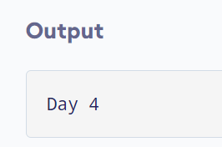
Example 2:
#include <iostream>
using namespace std;
enum week { Sunday, Monday, Tuesday, Wednesday, Thursday, Friday, Saturday };
int main()
{
week today;
today = Wednesday;
cout << "Day " << today+1;
return 0;
}

Slide 44
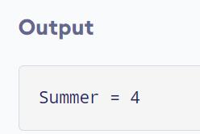
Example 3: Changing Default Value of Enums
#include <iostream>
using namespace std;
enum seasons { spring = 34, summer = 4, autumn = 9, winter = 32};
int main() {
seasons s;
s = summer;
cout << "Summer = " << s << endl;
return 0;
}

Slide 45
Find the output of below program
#include<iostream>
using namespace std;
enum color{
Black,
blue,
red
};
int main()
{
color obj = blue;
cout<<obj;
return 0;
}
(A) blue
(B) 2
(C) 1
(D) None of these

Slide 46
Find the output of below program
#include<iostream>
using namespace std;
enum color{
Black,
blue,
red
};
int main()
{
color obj = blue;
cout<<obj;
return 0;
}
(A) blue
(B) 2
(C) 1
(D) None of these

Slide 47
Find Output:
#include<iostream>
using namespace std;
enum color{
black=1,
blue,
red
};
int main()
{
color obj = blue;
cout<<obj;
return 0;
}
(A) blue
(B) Compilation Error
(C) 1
(D) 2

Slide 48
Find Output:
#include<iostream>
using namespace std;
enum color{
black=1,
blue,
red
};
int main()
{
color obj = blue;
cout<<obj;
return 0;
}
(A) blue
(B) Compilation Error
(C) 1
(D) 2

Slide 49
Find Output:
#include<iostream>
using namespace std;
enum color{
black=1,
blue,
red
};
int main()
{
color obj =yellow;
cout<<obj;
return 0;
}
(A) yellow
(B) Compilation Error
(C) 1
(D) 2

Slide 50
Find Output:
#include<iostream>
using namespace std;
enum color{
black=1,
blue,
red
};
int main()
{
color obj =yellow;
cout<<obj;
return 0;
}
(A) yellow
(B) Compilation Error
(C) 1
(D) 2

Slide 51
Using Enum inside the class
#include <iostream>
using namespace std;
class Year {
public:
enum Month {
JANUARY, FEBRUARY, MARCH, APRIL, MAY, JUNE,
JULY, AUGUST, SEPTEMBER, OCTOBER, NOVEMBER, DECEMBER
};
void setMonth(Month month) {
currentMonth = month;
}
Month getMonth() {
return currentMonth;
}
string getMonthString(Month month) {
switch (month) {
case JANUARY: return "JANUARY";
case FEBRUARY: return "FEBRUARY";
case MARCH: return "MARCH";
case APRIL: return "APRIL";
case MAY: return "MAY";
case JUNE: return "JUNE";
case JULY: return "JULY";
case AUGUST: return "AUGUST";

Slide 52
case SEPTEMBER: return "SEPTEMBER";
case OCTOBER: return "OCTOBER";
case NOVEMBER: return "NOVEMBER";
case DECEMBER: return "DECEMBER";
default: return "Invalid month";
}
}
private:
Month currentMonth;
};
int main() {
Year year;
int month;
cin >> month;
if (month >= 1 && month <= 12) {
// Subtracting 1 from the input to match the enum values
Year::Month selectedMonth = static_cast<Year::Month>(month - 1);
year.setMonth(selectedMonth);

Slide 53
cout << "Month: " << year.getMonthString(year.getMonth()) << endl;
} else {
cout << "Invalid month input" << endl;
}
return 0;
}

Slide 54
Thank you!
Any doubts?

